Slide 1
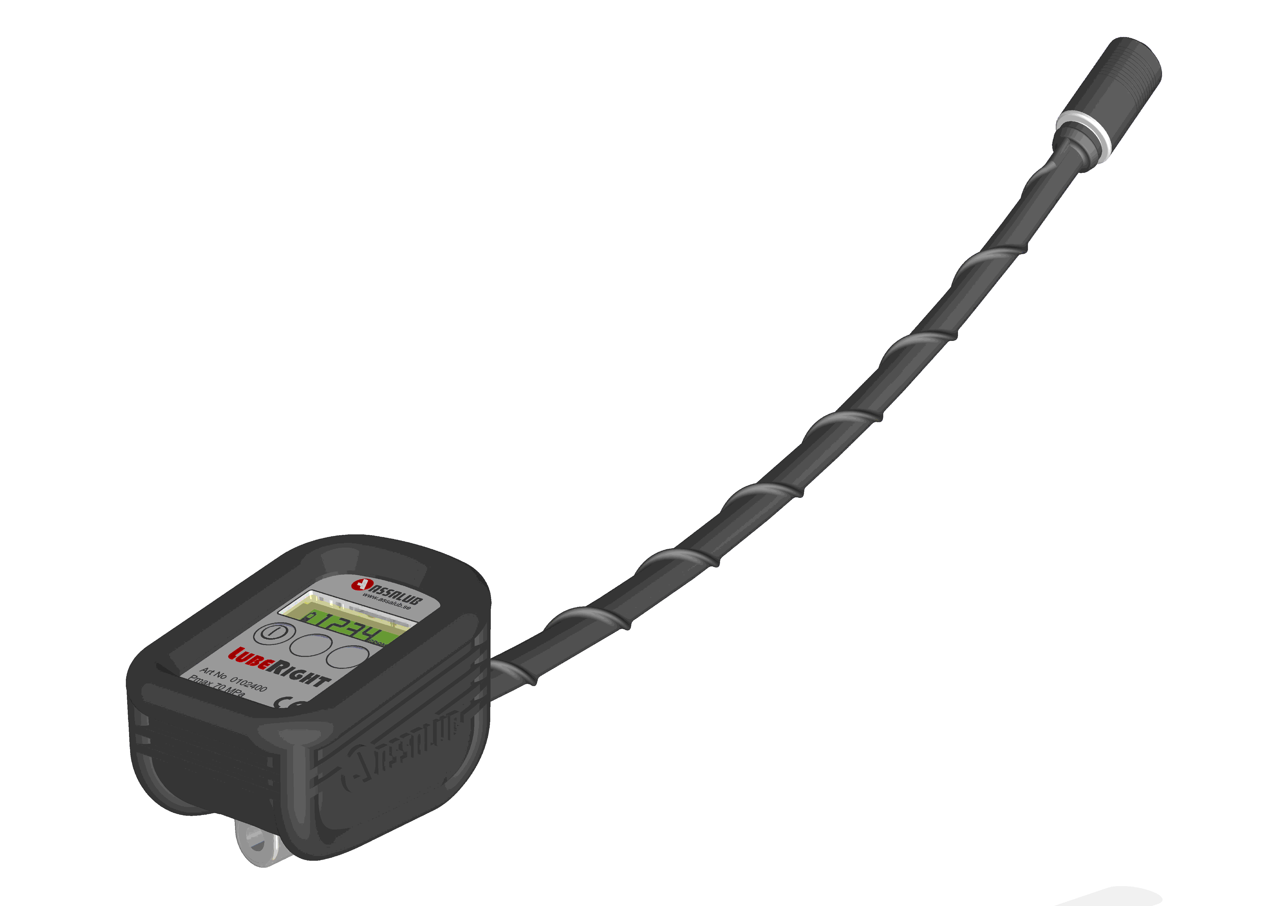
Computerised Manual Lubrication System
A new amazing product!
Notes:
LubeRight is a computer monitored manual greasing system.

Slide 2
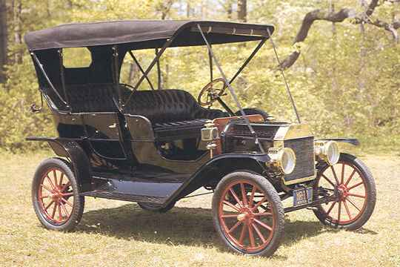
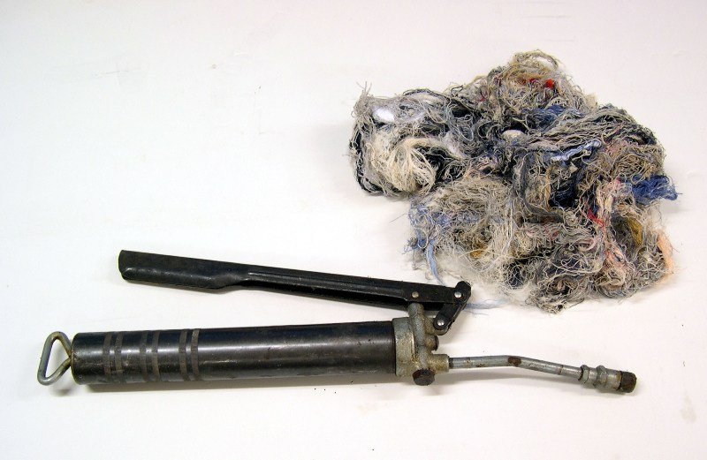
1908
Notes:
Typical representants for cars and lubrication equipment

Slide 3
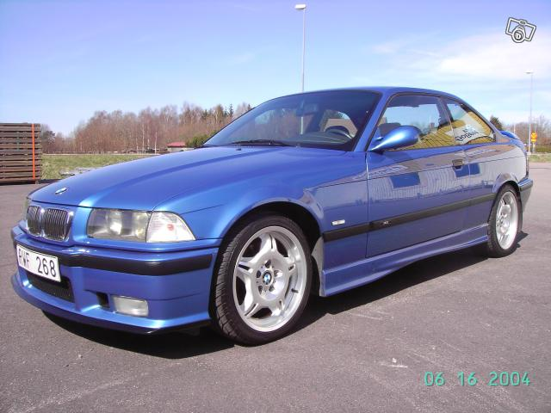
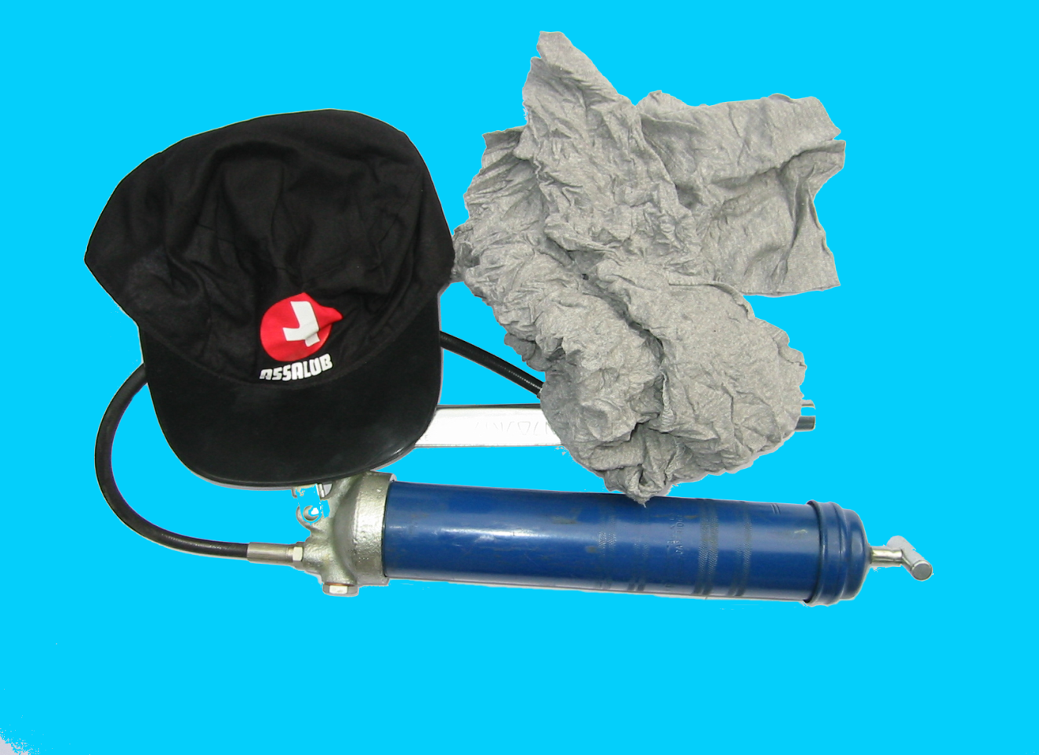
1996
Notes:
1n 1996 cars had developed quite a lot. In lubrication very limited progress had occured.

Slide 4
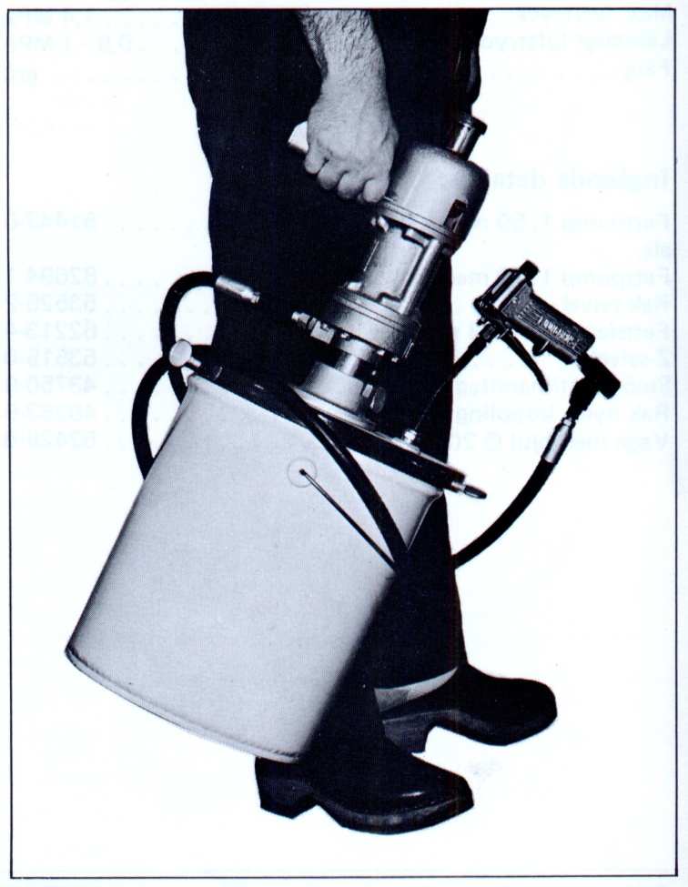
Manual Lubrication
IS DEVELOPEMENT STALLING?
Notes:
The equipments used were old and clumpsy.

Slide 5
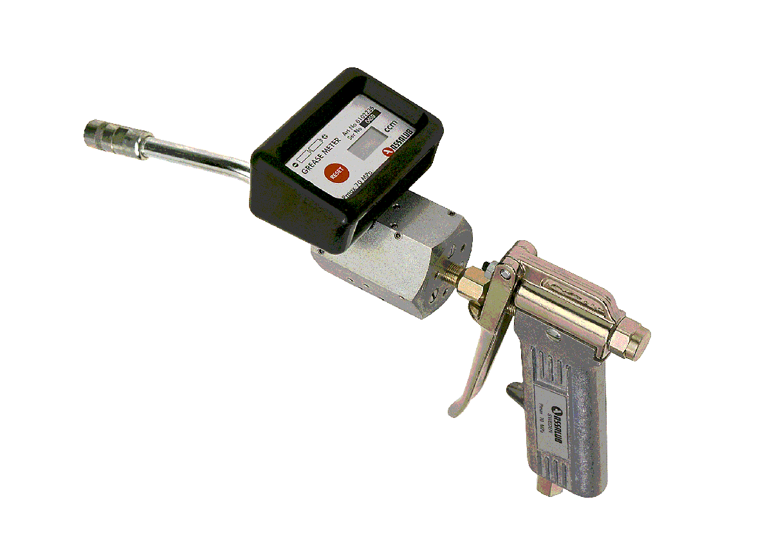
1997 Assalub introduced the first grease meter
Grease Meter
With display showing the volume fed.
Notes:
Assalub developed the first grease meter ever in 1997. Designvice it was a progressive divider with three pistons and a displacement of 1 ccm.

Slide 6
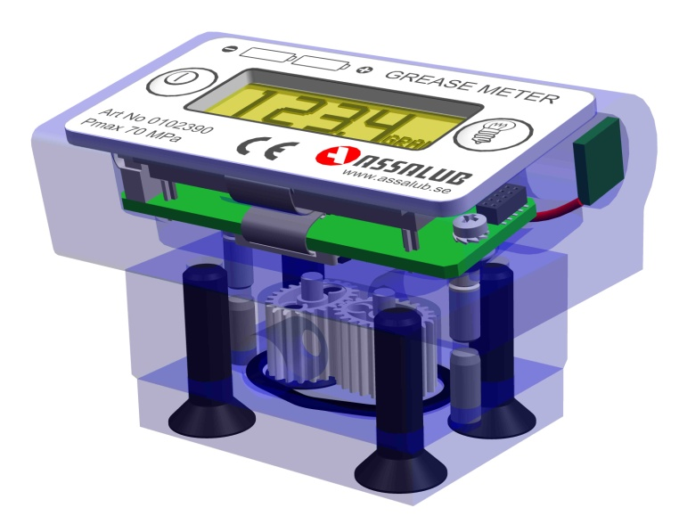
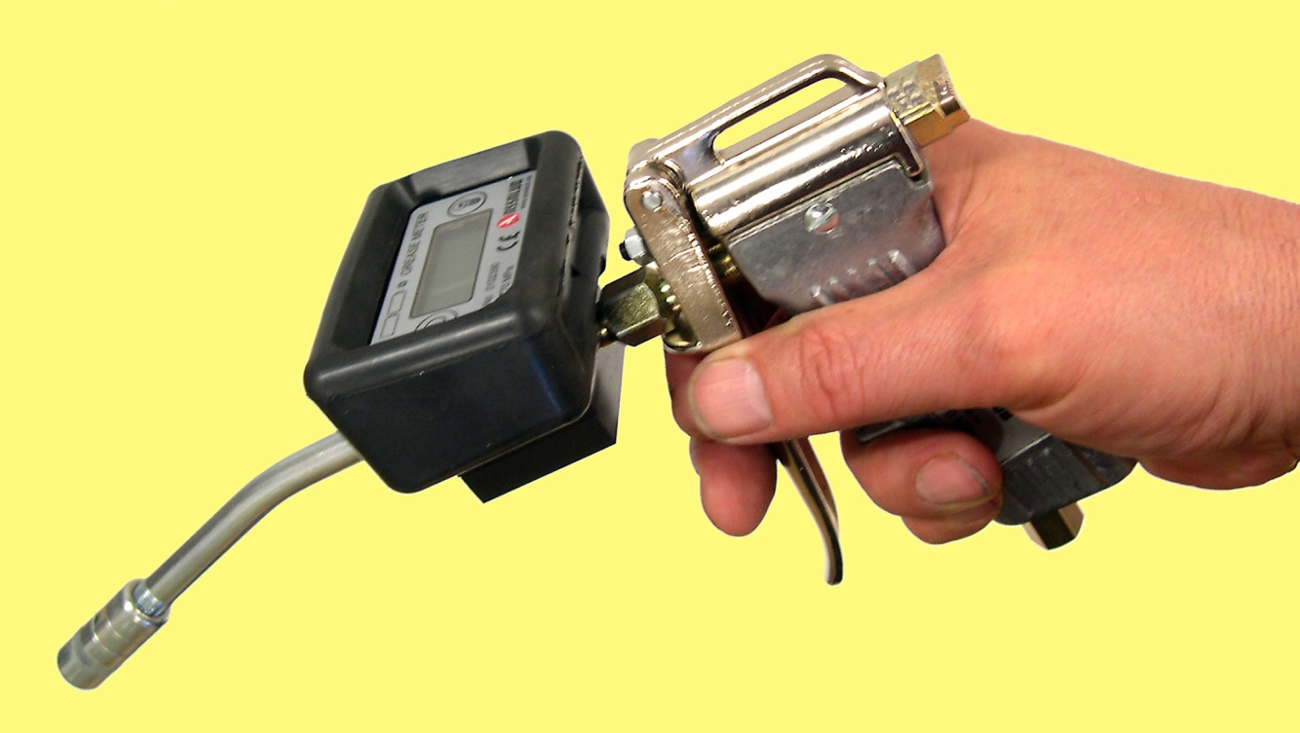
2004 Assalub introduced the next generation of the grease meter
GREASE METER MKII
Notes:
Later Mark II was introduced. It worked with an oval gear approach and was much lighter, less expensive and more versatile.

Slide 7
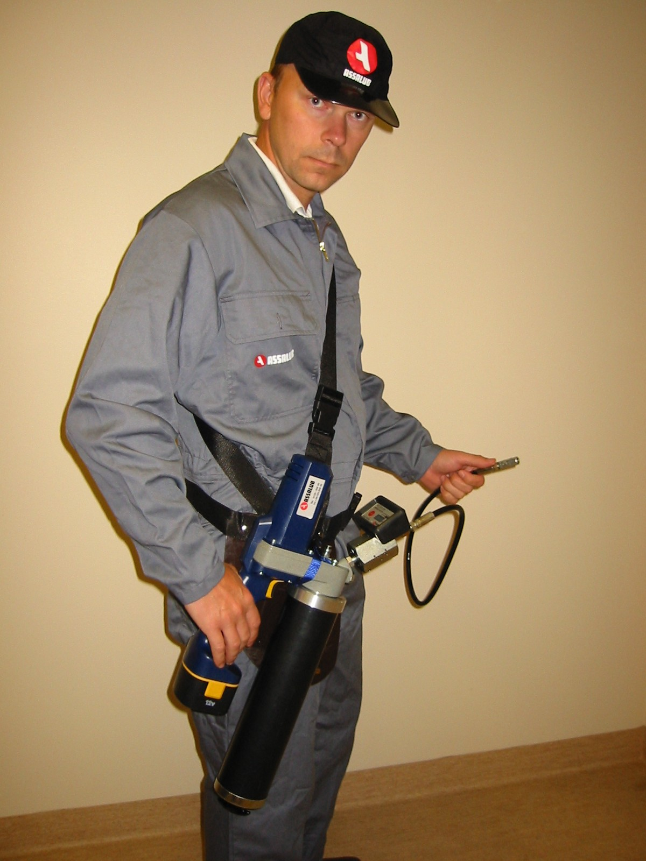
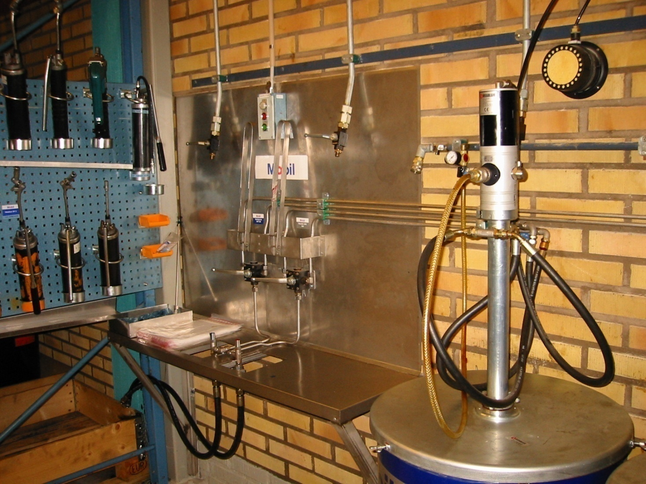
Grease handling
Lubricating with proper equipment
Filling grease from barrel, clean and airless
Notes:
At about the same time the Grease meter was developed, a new product was introduced on the market – the battery powered grease gun. Combined with Assalubs grease meter it started to become the most important tool in manual lubrication.
It became essential to replenish the cartridges with air-free grease. One of the most reliable means is by using Assalub´s Totally Empty pump concept.

Slide 8
In 1997 MoDo in Örnsköldsvik aquired their first Grease Meter. In 1999 the Grease Meter was used with all manual lubrication.
A reduction of 50 % of grease used was achieved in the machine hall. In addition spare part costs went down.
Notes:
The mill bought their first Grease meter in 1997. In 1999 all manually greased points on one of the pulp machines were greased with a battery powered gun equipped with a grease meter. Apart from a huge decrease in grease consumption, a substantial reduction of spare part consumption was notified. On an annual basis about USD 3 millions! Simultaneously a balancing of rolling elements was conducted in the mill. It is hard to say what is the impact of a each activity. Both of them contributed to the spare part savings.

Slide 9
The Grease Meter tells exactly how much grease has been fed.
But one also wants to know:
To which greasing point?
When?
Achieving this requires:
A safe identification of the greasing point.
Storage of the above info in the Meter.
Notes:
Once we were able to control the right amount of grease to each point, we realized that if we would register what we had done, we would have a system that could monitor all manually greased points on a site.

Slide 10
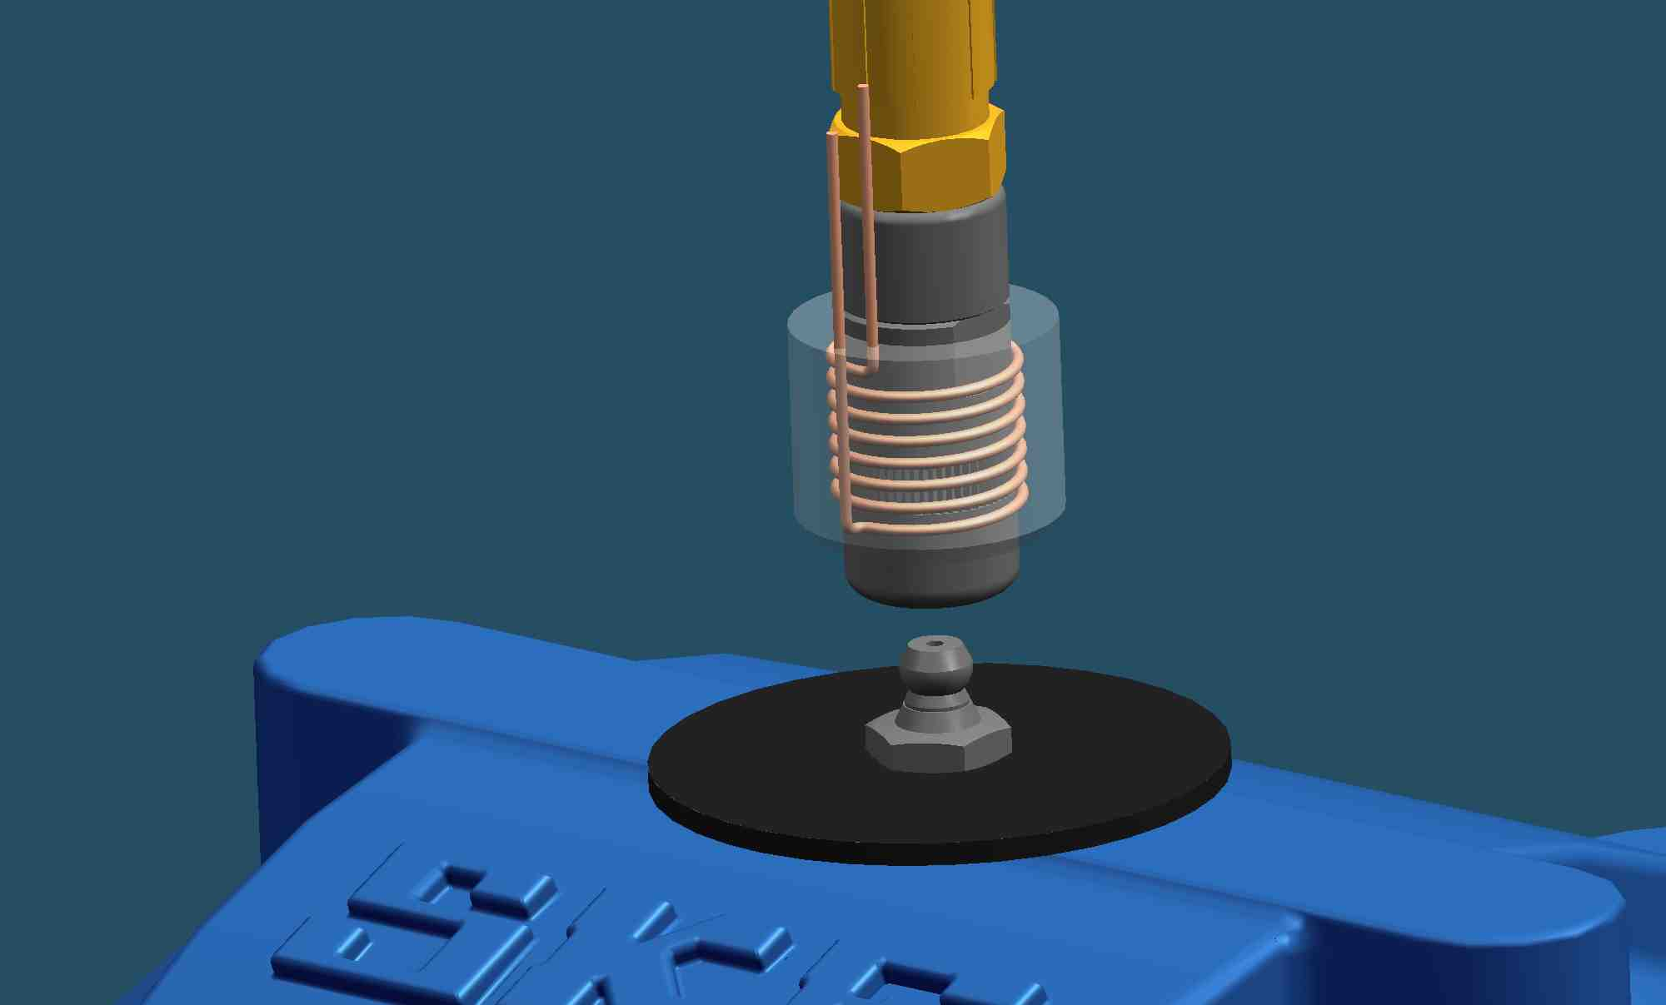
Identification
Identification of the greasing point by RFID (Radio-Frequency Identification)
Works in polluted environments
Correct reading distance
Notes:
We drcided to use RFID technology and started to find out the correct reading parameters. The system must always read the transponder of the correct greasing point. Therefor it shall only read the transponder when the coupling has clicked to the nipple.

Slide 11
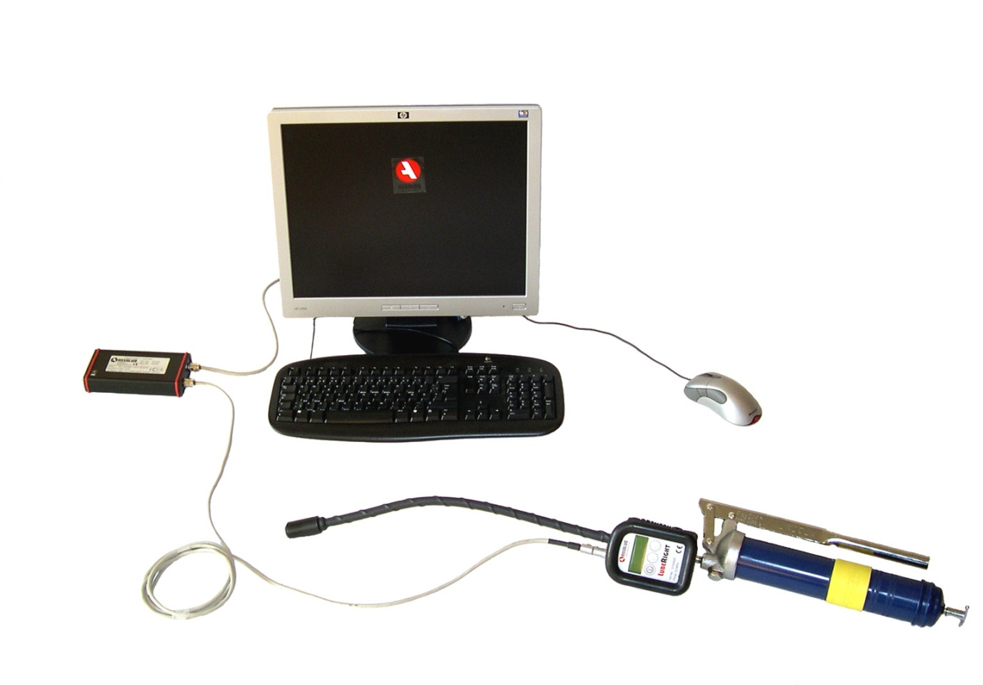
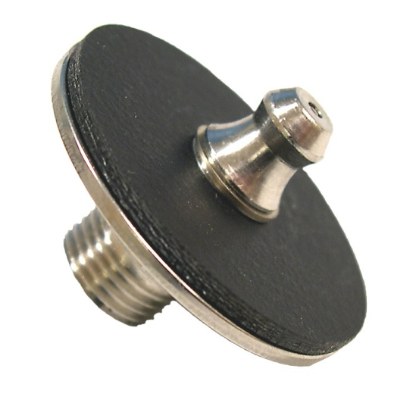
LubeRight Components
GREASING NIPPLE WITH TAG (TRANSPONDER)
SOFTWARE
COMMUNICATION AND CHARGING UNIT
GREASE METER
Notes:
The system consist of: The Grease meter, the Communication and charging unit, transponders and Soft ware. Usually the program is used in a PC but it can also be loaded into a server.

Slide 12
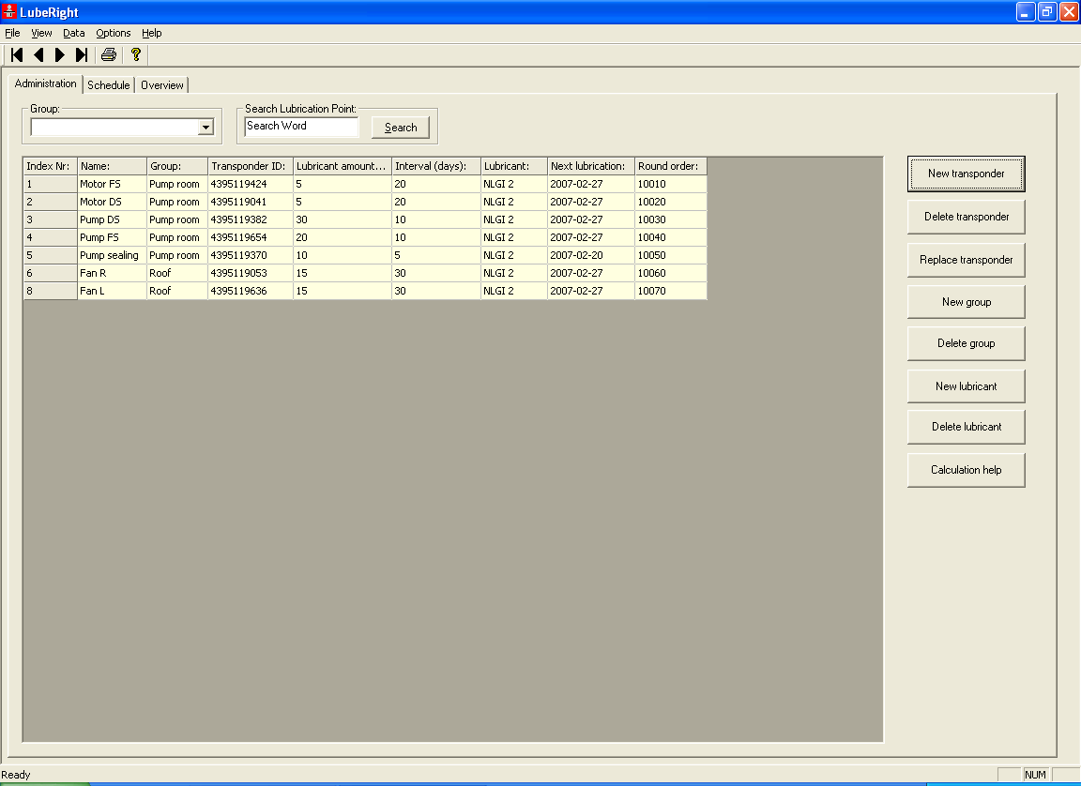
HOW IT WORKS
REGISTRATION OF GREASING POINTS
Name
Group
Lubricant amount
Interval
Lubricant
Notes:
All greasing points must be registered in the system. Normally the old group (or route) can be used.

Slide 13
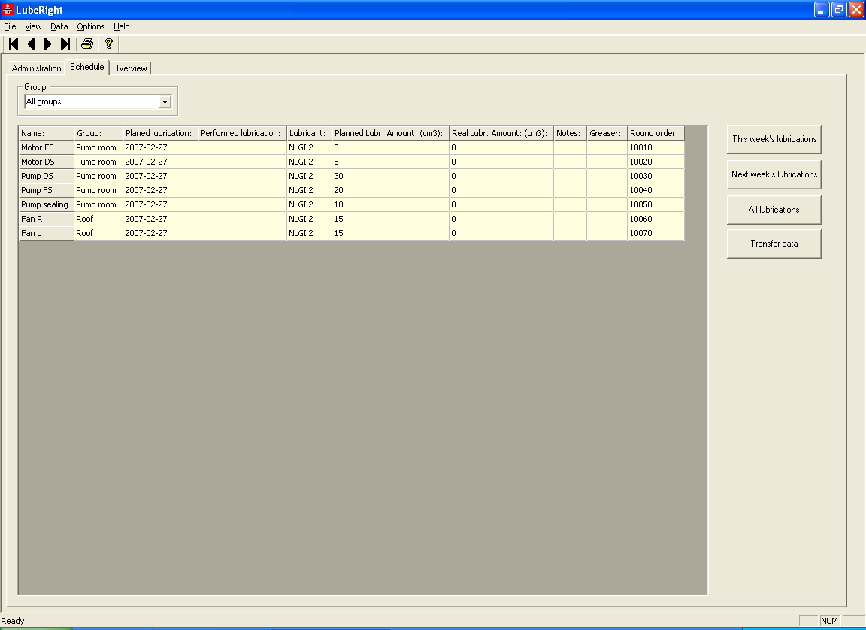
TARGET GREASING POINTS ARE TRANSFERRED TO THE GREASE METER
Notes:
When greasing is carried out, a route is loaded into the grease meter.

Slide 14
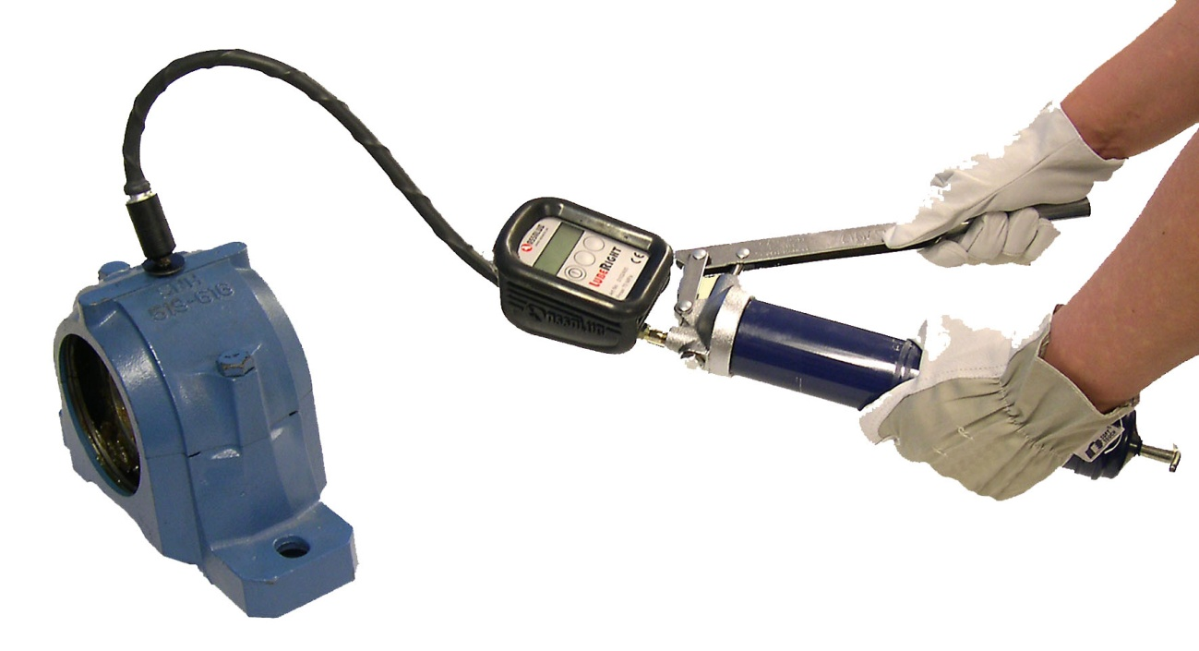
Performing the greasing
THE AMOUNT OF GREASE REQUIRED IS SHOWN ON THE DISPLAY
THE REAL AMOUNT FED INTO THE GREASING POINT WILL BE REGISTRED BY THE METER

Slide 15
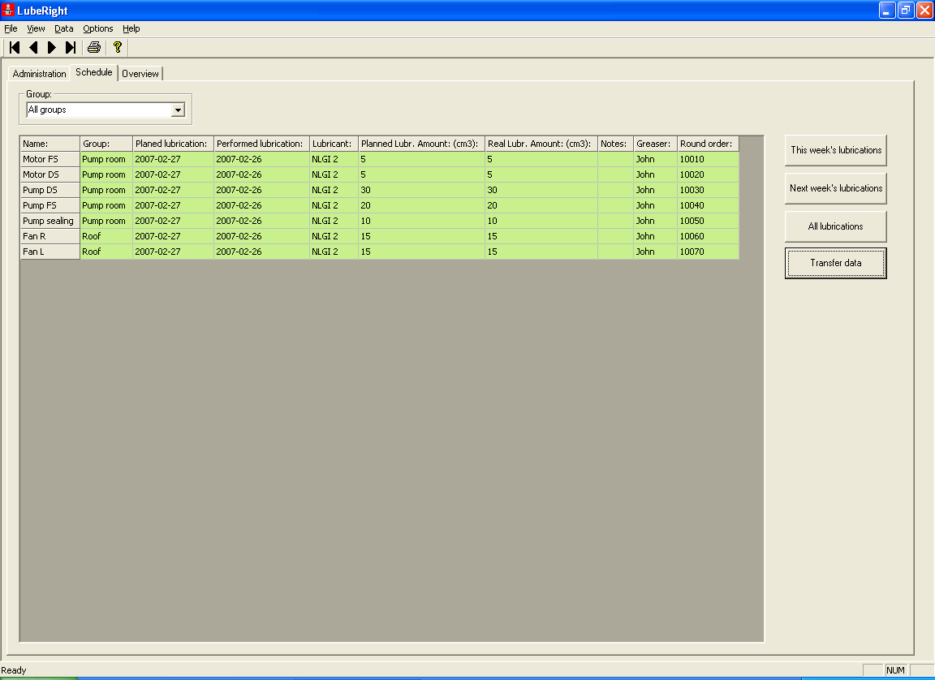
THE PERFORMED LUBRICATION IS TRANSFERRED FROM THE METER TO THE COMPUTER
Notes:
Then the greasing has been performed the grease meter is again connected to the PC and the result loaded into the PC.

Slide 16
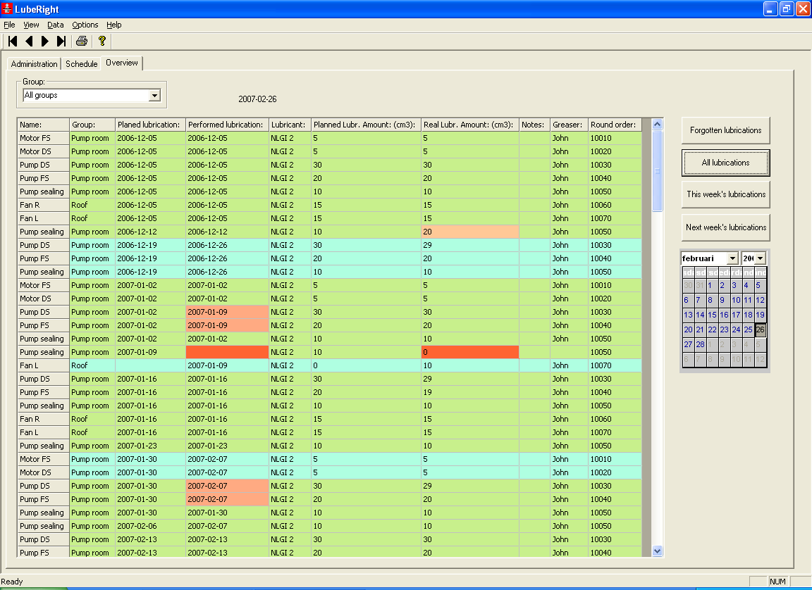
FOLLOW UP
AVAILABLE INFORMATION:
Which points have been lubricated.
When.
How much.
Which points have been forgotten.
LubeRight OFFERS TOTAL CONTROL OF EVERY SINGLE GREASING POINT
Notes:
Immediately the result will be showed on the display.
A green line means that the lubrication was performed correctly in the right time.
If the grease amount fiels is red, it means that the actual fed quantity deviates more than 10 % from the planned quantity.
When the performed lubrication date is red, it means that the lubrication was made too late or too early.
If the whole line is blue, the lubrication was made later than planned due to machine stoppage.
When the whole line is marked red it means that the lubrication was performed too late (and will always be red).

Slide 17
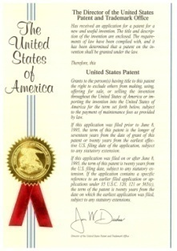
Other customers:
Billerud AB, Gruvön Mill
Stora Enso, Skoghall
Cementa, Degerhamn
Outokumpu Degerfors
Scania
Sandvik
Corus, (Brittish Steel)
Stora Enso, Kvarnsveden
Princess Cruises
Boliden, Garpenberg
Debswana, Botswana
E.ON, Germany
First installation at Stora Enso Pulp Mill, Skutskär
Now, approx. 5000 lubrication points installed.
Notes:
Some of the users

Slide 18
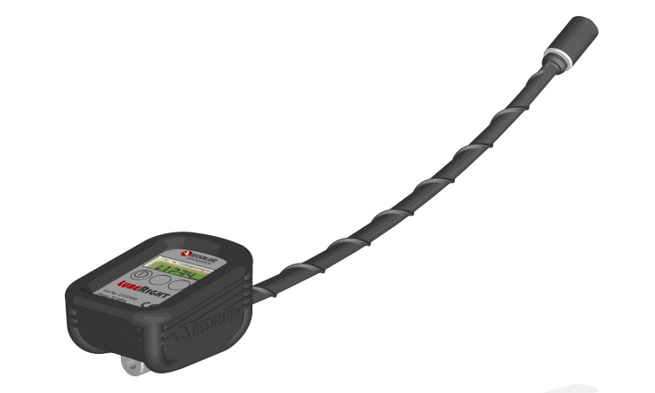
Hardware
GREASE METER
Digital grease meter with antenna for communication with lubrication nipples. The grease meter has a contact for connection to the power supply and communication unit.
Data
Max. pressure 70 MPa
Grease connection int. ISO-G1/8
Weight 0.8 kg
Hose length 400 mm
Flow range 0-1000 cm³/min.
Accuracy +/- 3 % up to 300 bar
Protection IP54
Temp. range -20 °C - +40 °C
The grease meter is equipped with a resettable total counter. It can be calibrated and can show the grease amounts in cm³, g, oz. or fl. oz.
The display of the grease meter is equipped with a backlight for use in dark working environments.

Slide 19
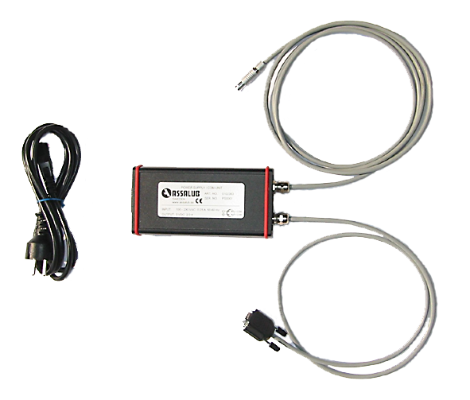
Hardware
Power Supply and Communication Unit
Communication
The unit is connected between the grease meter and the PC when information needs to be transferred.
Charging
Charging takes approx. 15 hours.
Data
Supply voltage 100-230 VAC 50-60 Hz
Power max 0.25 A
Output voltage 5 VDC 2.0 A
Protection IP20
Weight 0.8 kg

Slide 20
Hardware
Lubrication Nipple with Transponder
The transponder has a unique number that the grease meter identifies.
Stiffening plate and locking ring in acidproof steel. Lubrication nipple in zinc plated or acid proof steel. Transponder in epoxy.
Connection thread: ISO-G1/8 or NPT 1/8
Type of lubrication nipple in accordance with
DIN 71412
Temperature range: -40 °C to +85 °C
Protection: IP66
Weight: 20 g

Slide 21
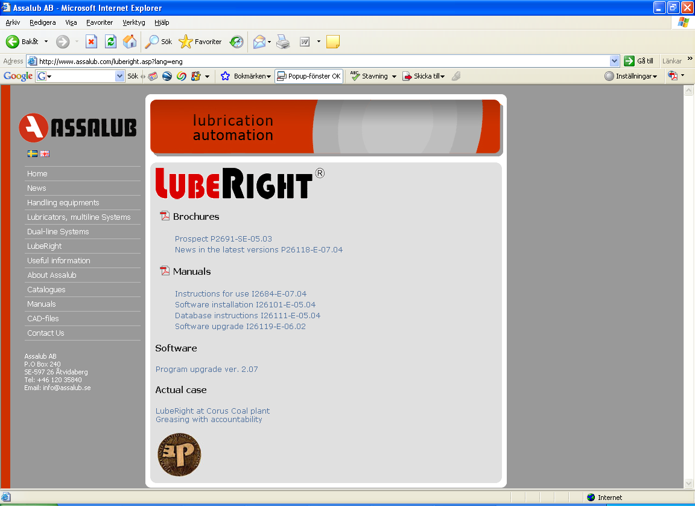
Internet
www.assalub.com
Notes:
On our web site you will find leaflets and manuals as well as a short film showing how the system works.

