Slide 1
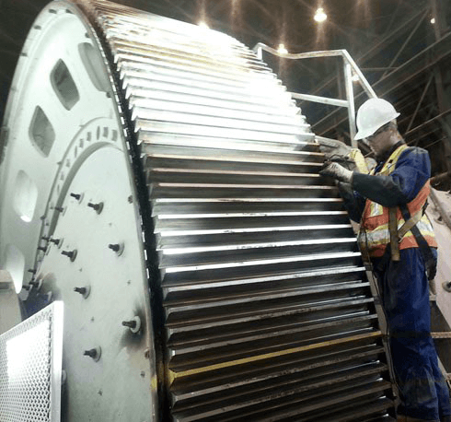
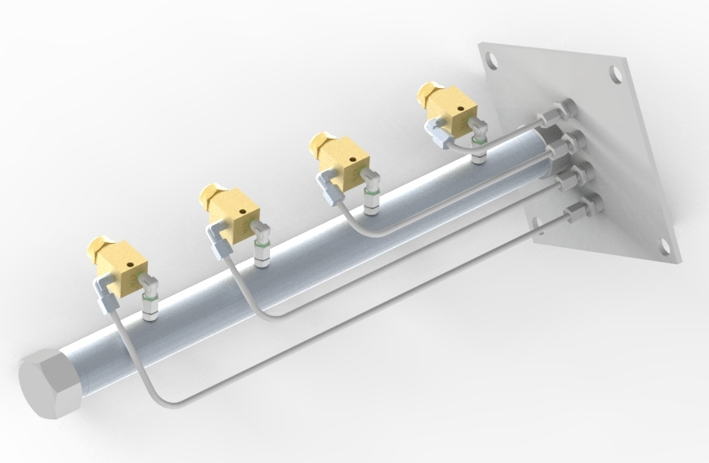
Open Gear Grease Spray Lubrication

Slide 2
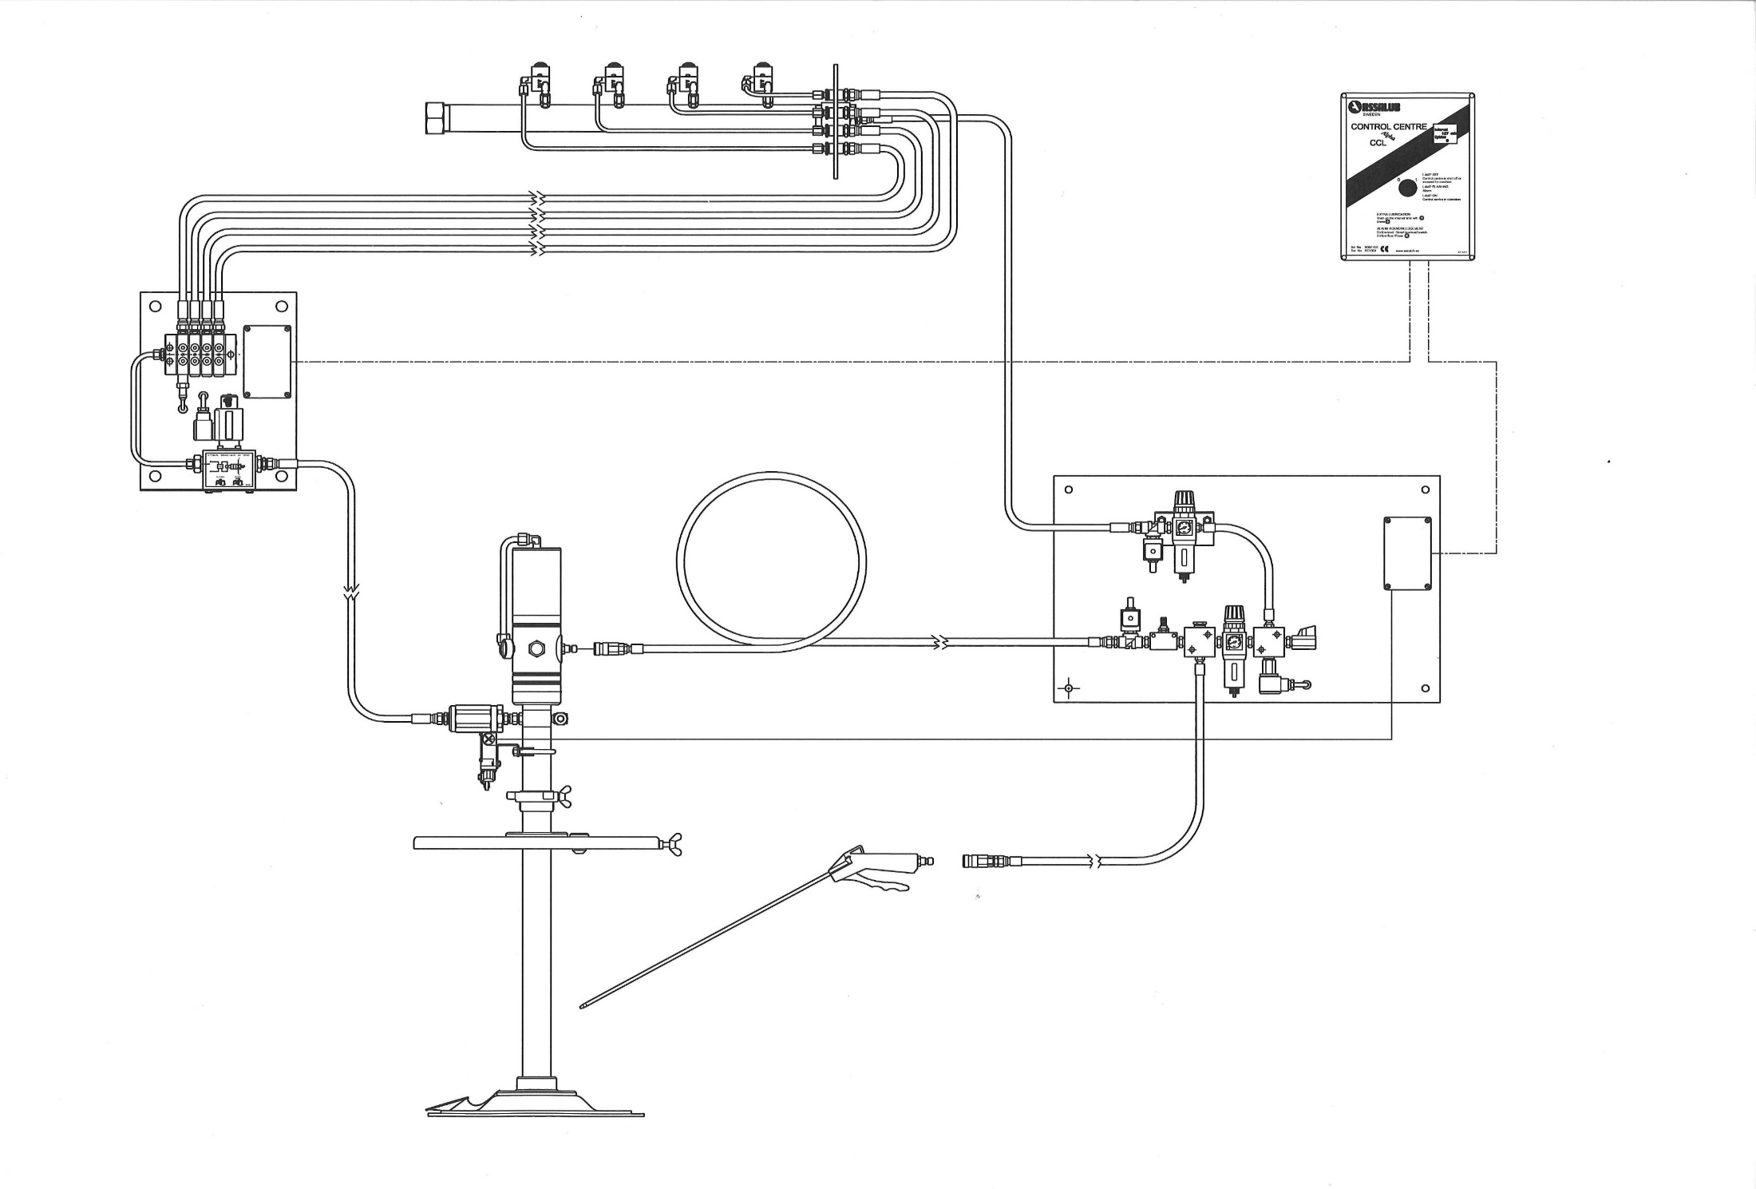
CONTROL UNIT
SPRAY NOZZLE LANCE
PROGRESSIVE DISTRIBUTOR
AIR PANEL
GREASE PUMP

Slide 4
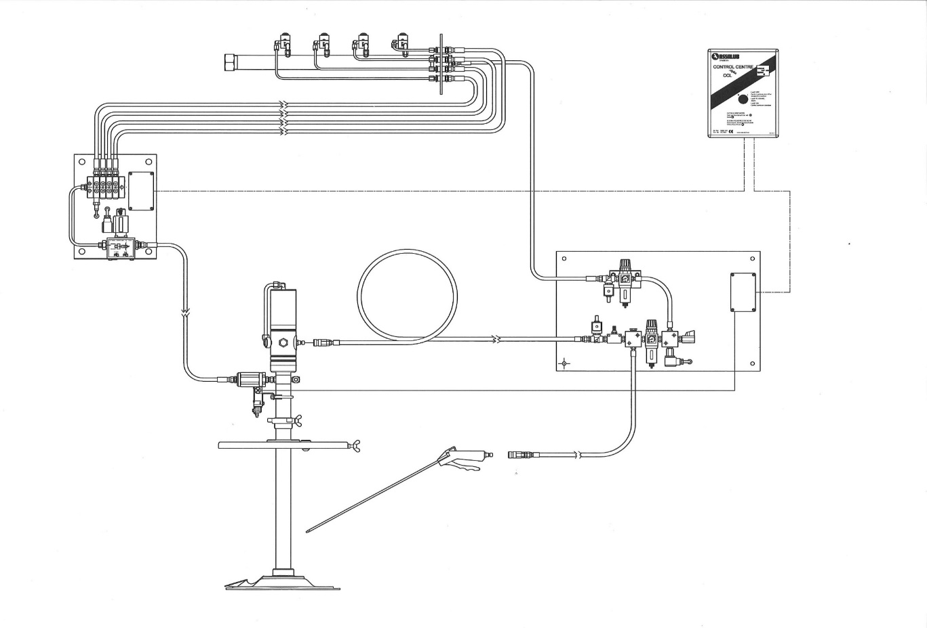
Advantages
Few components
High quality components
Easy to install
Gives a safe and reliable system

Slide 5
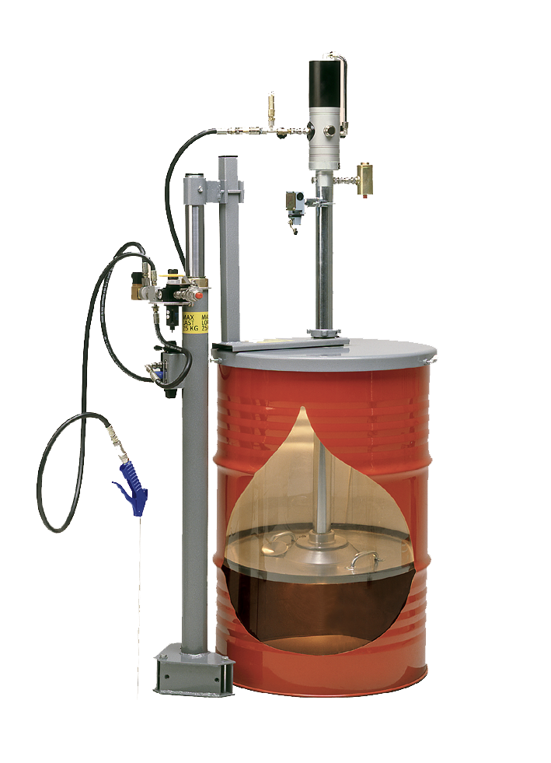
Grease Pump
Avaliable for 16 – 200 kg drum.
Pressure ratio 1:65
”Totally Empty Concept” that empties the grease drum completely.
With low level switch.
The follower plate protects the grease from pollutions

Slide 6
Assalub Grease pump
Characteristics
- Easy to install a low level switch
- Easy to visually estimate the grease level
Notes:
Assalub’s grease pump is usually installed in large process industries. It is important that the level of grease can be estimated easily.

Slide 7
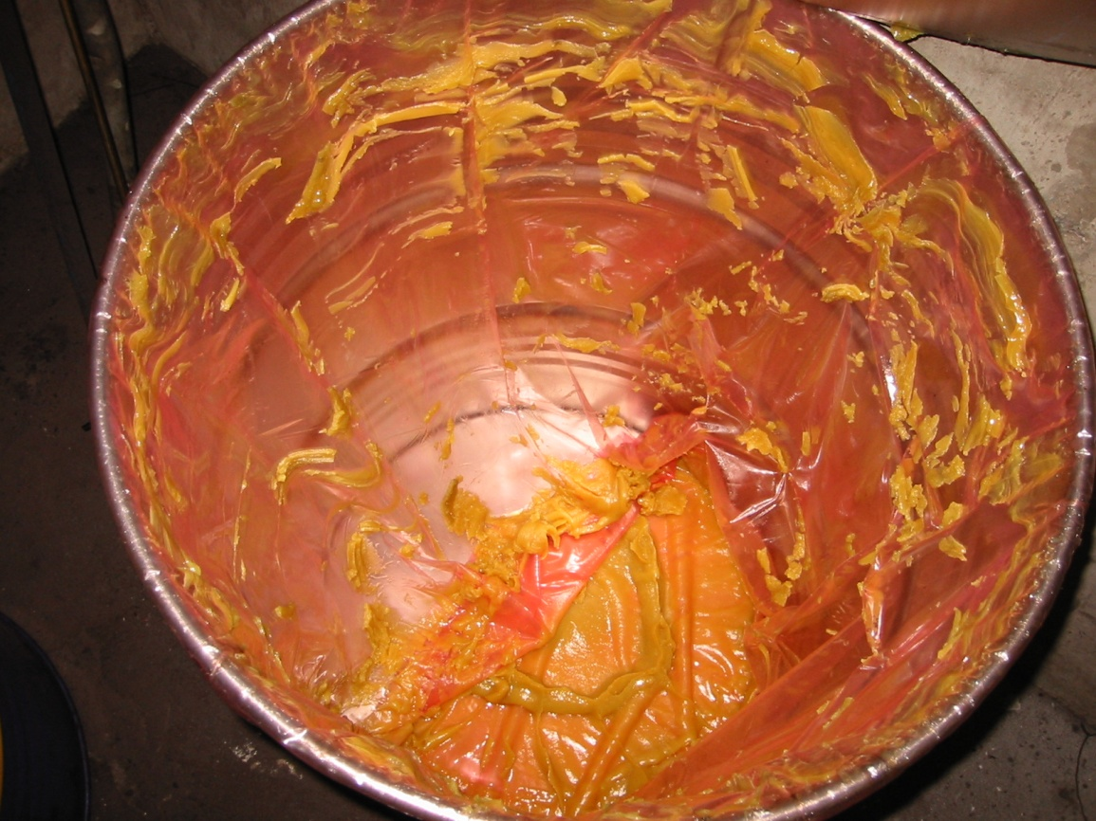
Assalub Grease pump
Characteristics
Empties the barrel to 98-99%
Notes:
This is how the barrels are emptied.

Slide 8
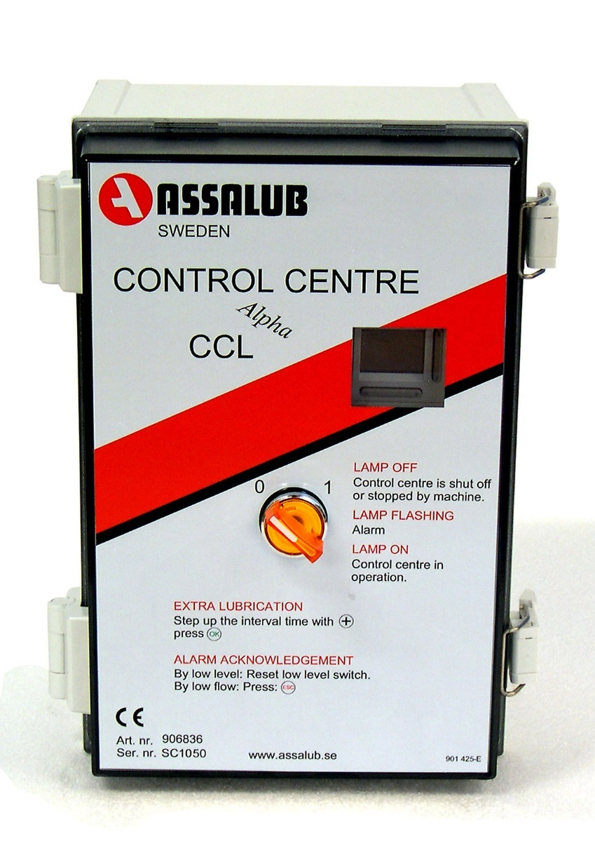
Control Centre
The Control Centre CCL Alpha controls and monitors the Open Gear Spray system.
FUNCTIONS
- Adjustable interval time, number of feeder cycles and extra spray time.
- Extra lubrication
- Machine-interlocking control.
- Output for operating indication.
- Output for alarm signal (activated at too low flow rate, low level of lubricant and too low air pressure.

Slide 9
Spray Lance
Avaliable with 1 – 4 spray nozzles for different gear width.
The tube works as an air accumulator and secure that each nozzle get the same air flow.
Easy to install in the open gear’s protecting hood.

Slide 10
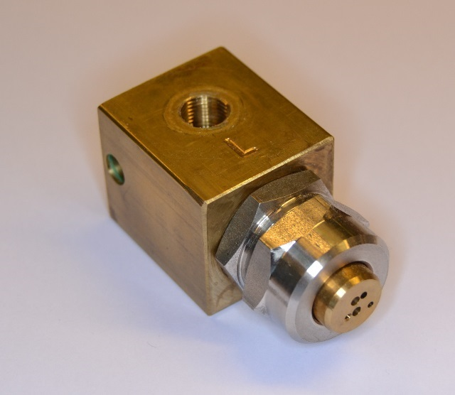
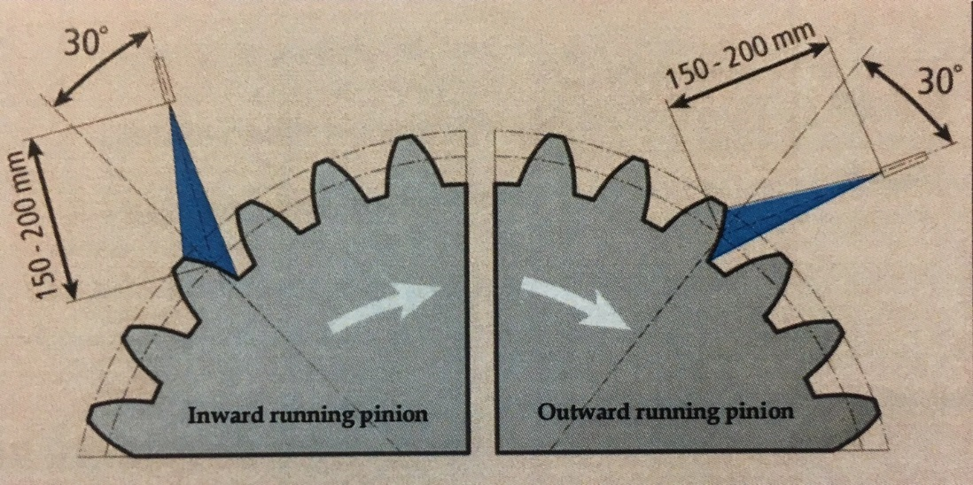
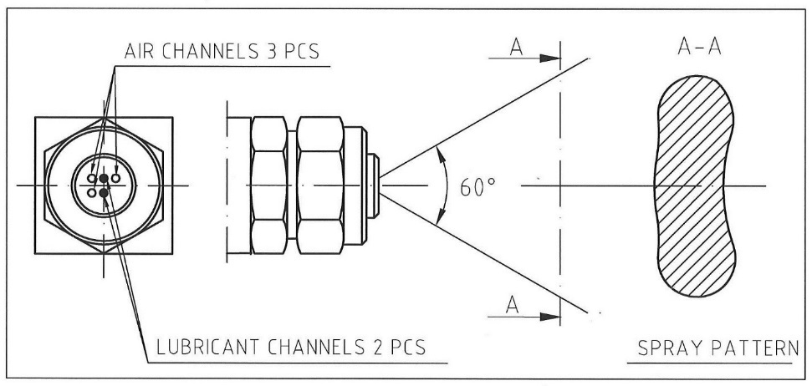
Spray Nozzles
Correct positioning of the nozzles is essential
60° spray angle

Slide 11
Air Panel
Solenoid valves for pump and spray nozzles.
Filter regulators for pump and spray nozzles.
Needle valve to adjust the grease flow from the pump.
Pressure switch to monitor the air pressure.

Slide 12
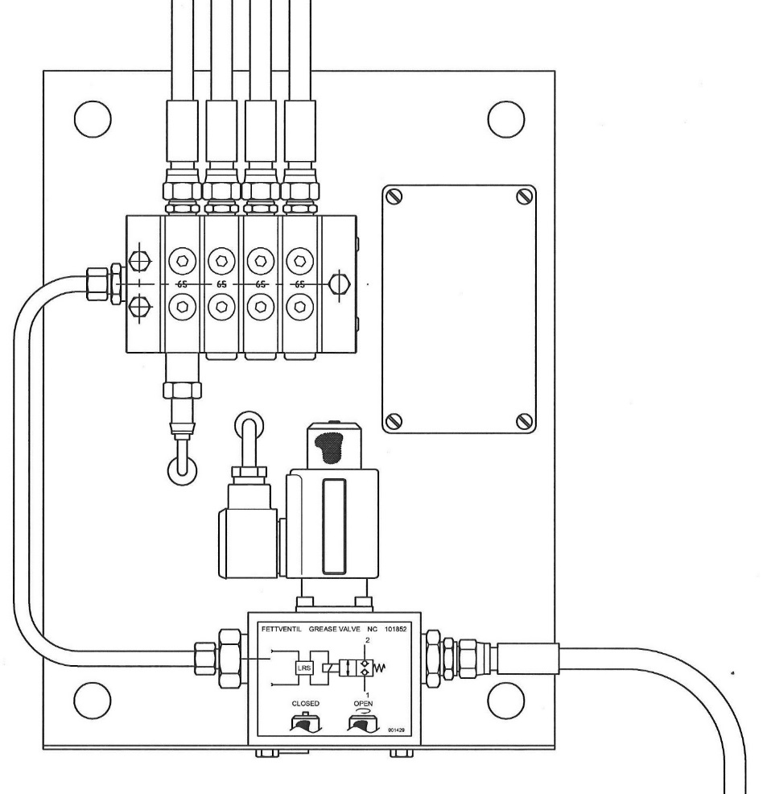
Progressive Distributor Unit
Grease valve
Progressive distributor with one outlet for each spray nozzle.
Inductive cycle transducer to count the amount of grease.

Slide 13
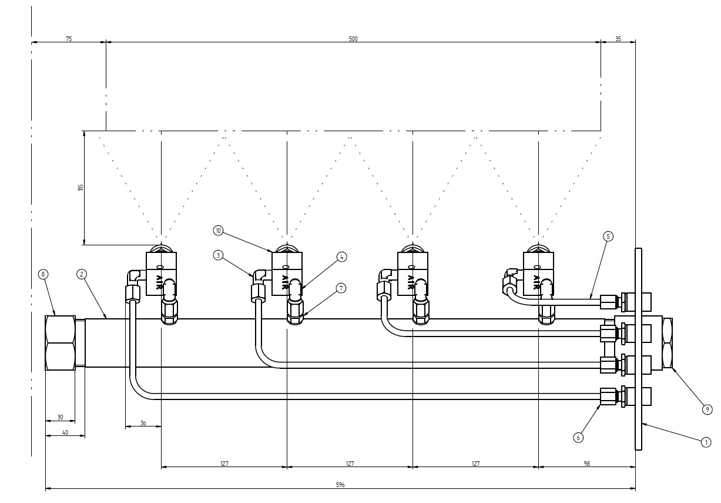
What we need to offer
B
A = gear width
B = distance from cover to gear

